Slide 2
Motivation

Slide 3
Related Work: Simulated Ecosystems

Slide 4
Related Work: Lindenmayer-Systems

Slide 5
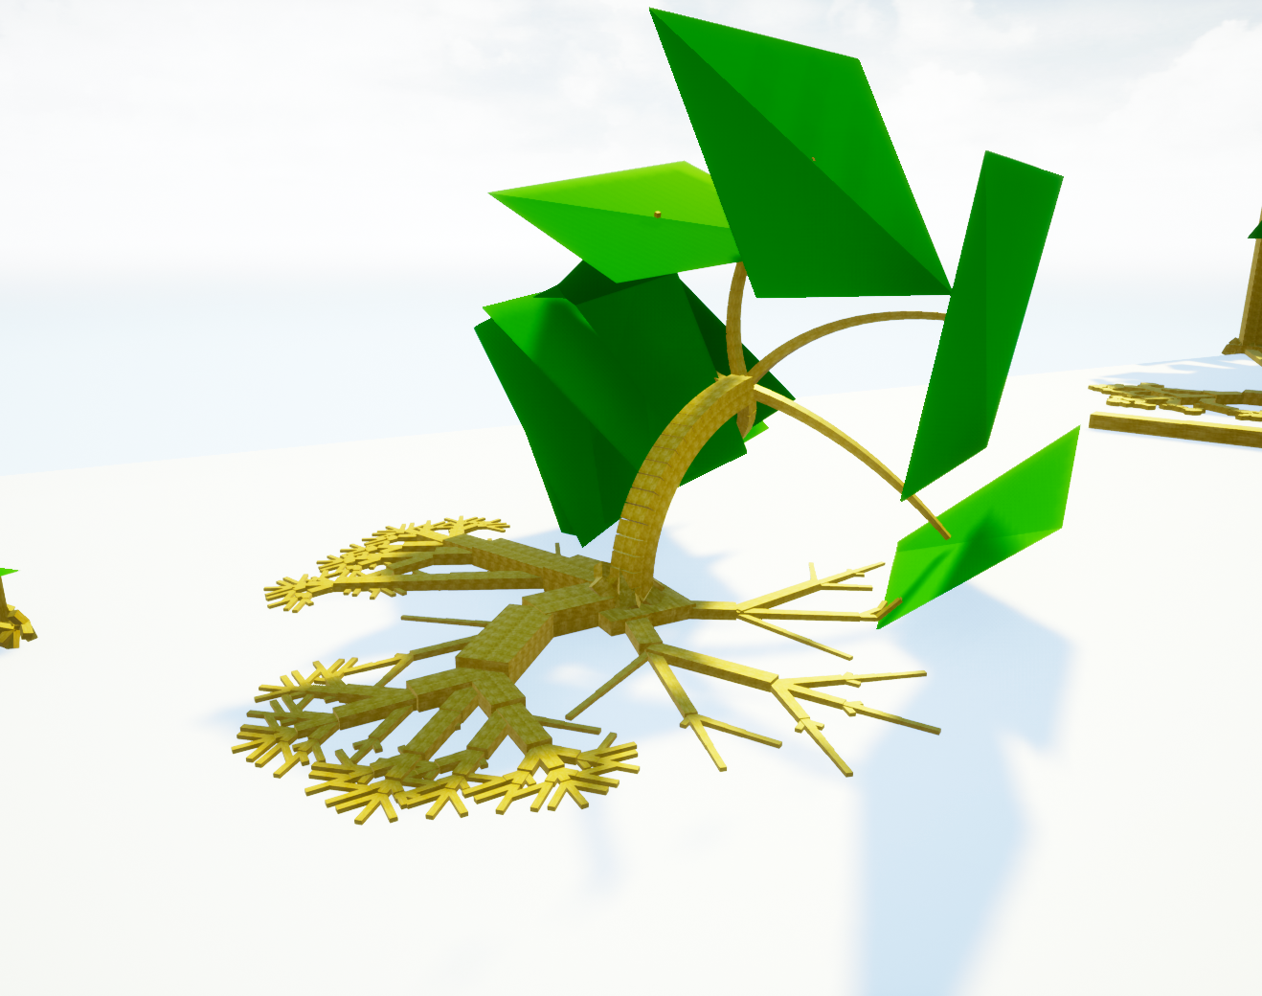
Fundamental Ideas

Slide 6
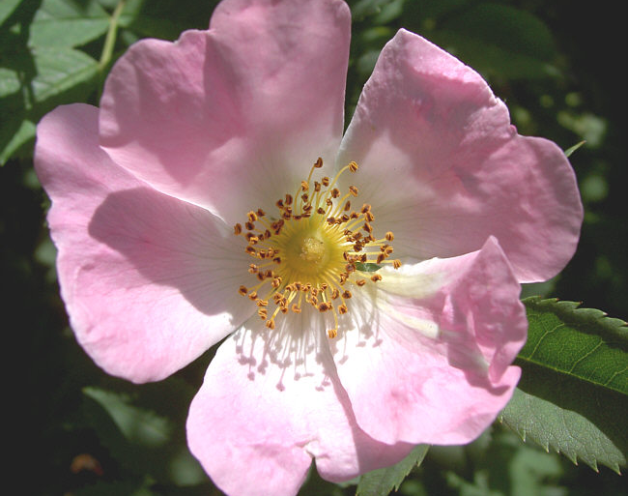

Slide 7
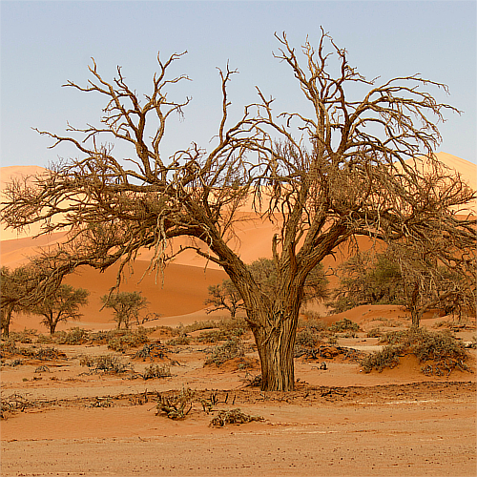

Slide 8
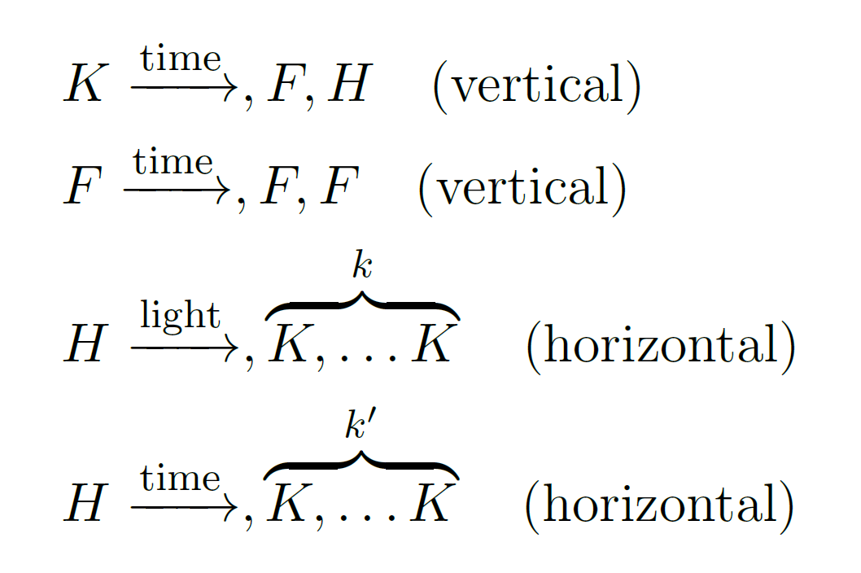
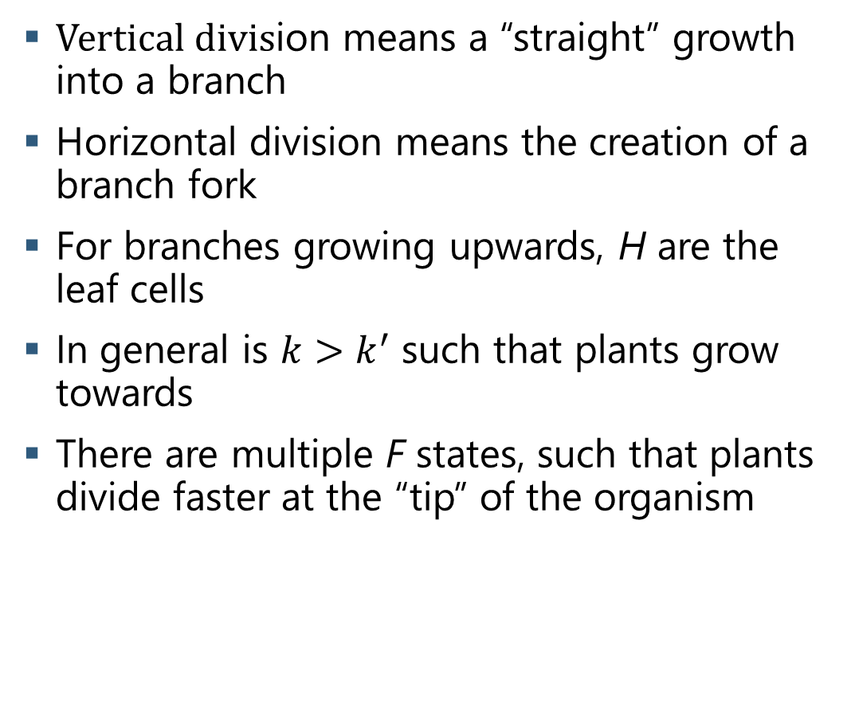
Division Rules
$\text{Vertical} \text{divis}$ion means a “straight” growth into a branch
Horizontal division means the creation of a branch fork
For branches growing upwards, H are the leaf cells
In general is $k>k^{′}$ such that plants grow towards
There are multiple F states, such that plants divide faster at the “tip” of the organism

Slide 9
Division Rules

Slide 10
Division Rules
Vertical division means „straigth“ growth into a branch
Multiple F states, so that plants grow faster at the “tip”

Slide 11
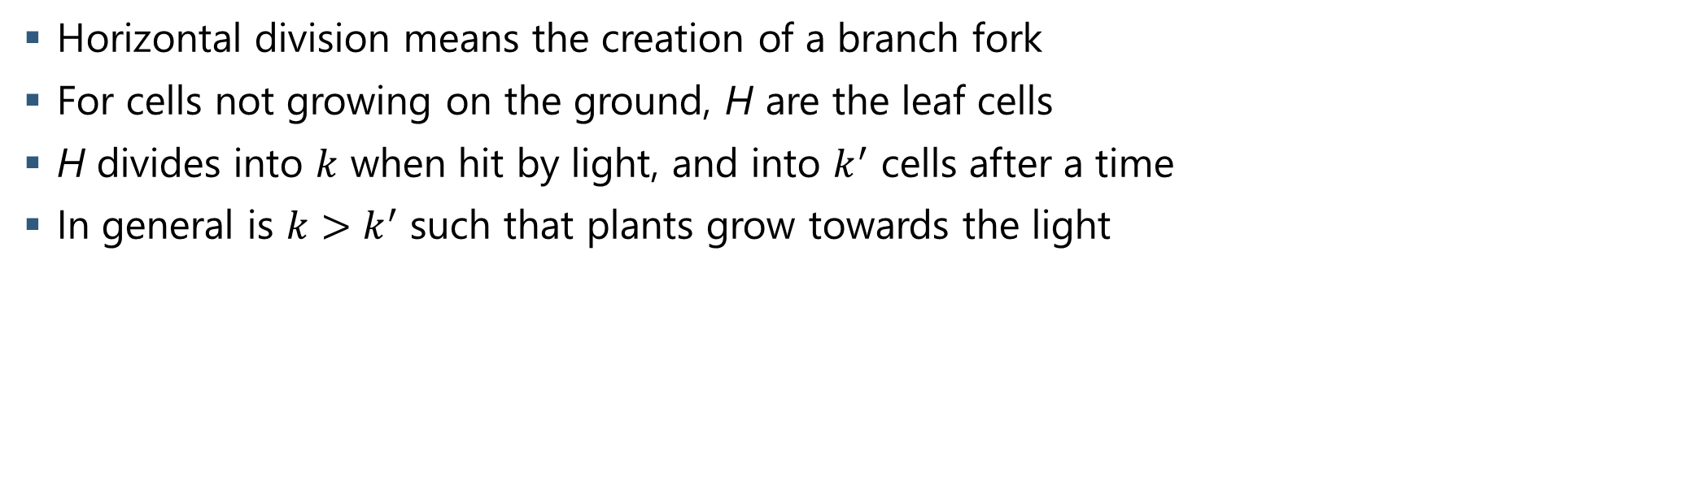
Division Rules
Horizontal division means the creation of a branch fork
For cells not growing on the ground, H are the leaf cells
H divides into $k$ when hit by light, and into $k^{′}$ cells after a time
In general is $k>k^{′}$ such that plants grow towards the light

Slide 12
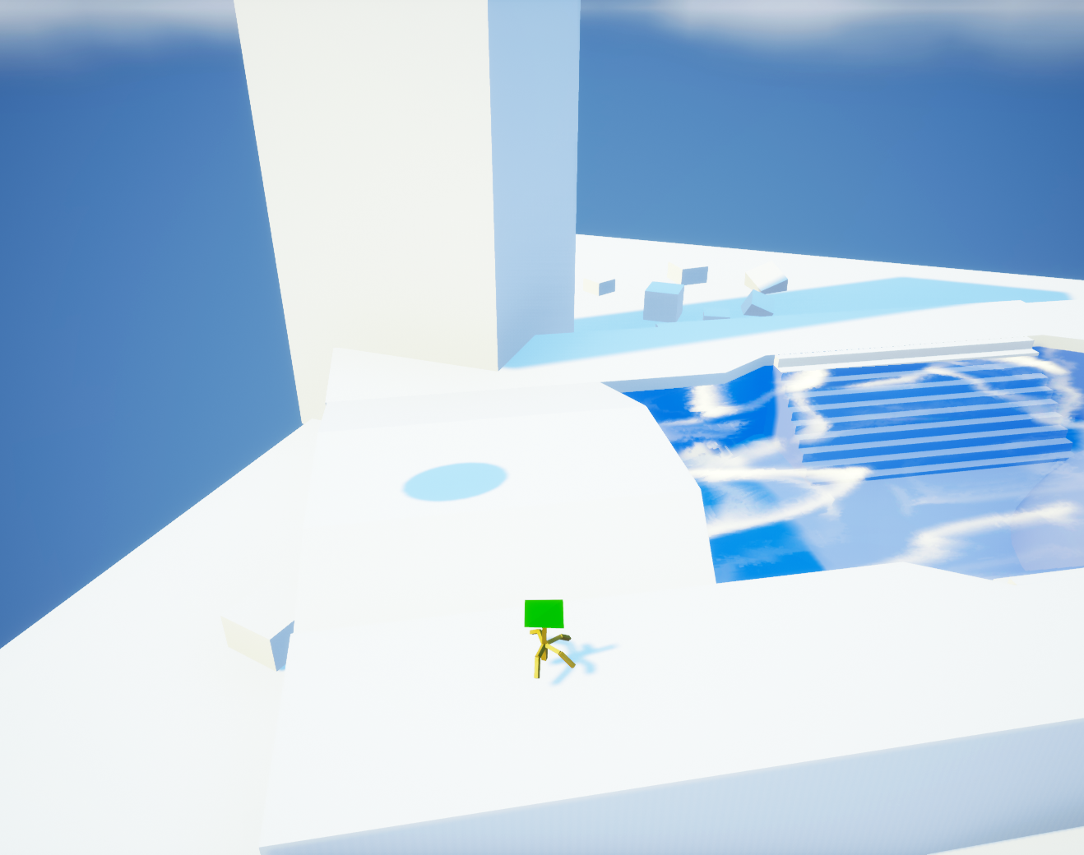
Plant Grow
5 Iterations

Slide 13
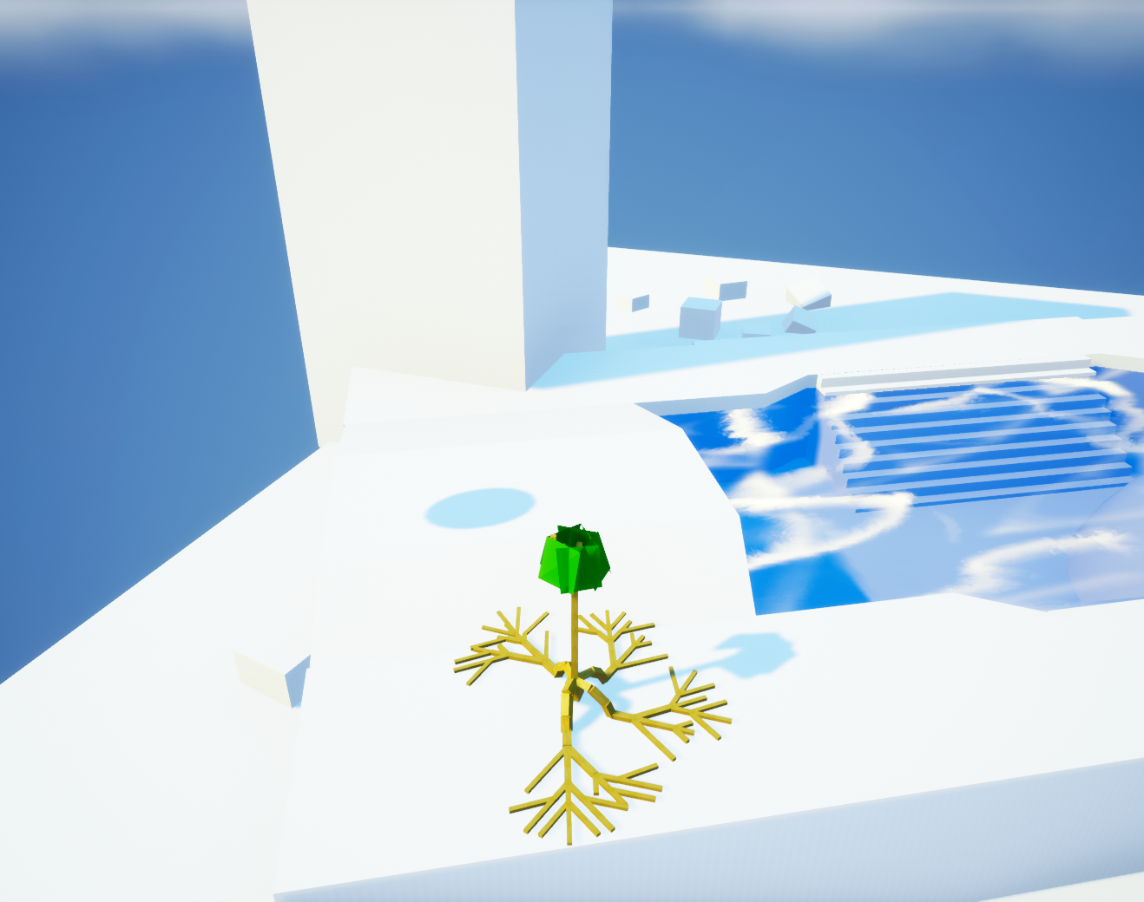
Plant Grow
20 Iterations

Slide 14
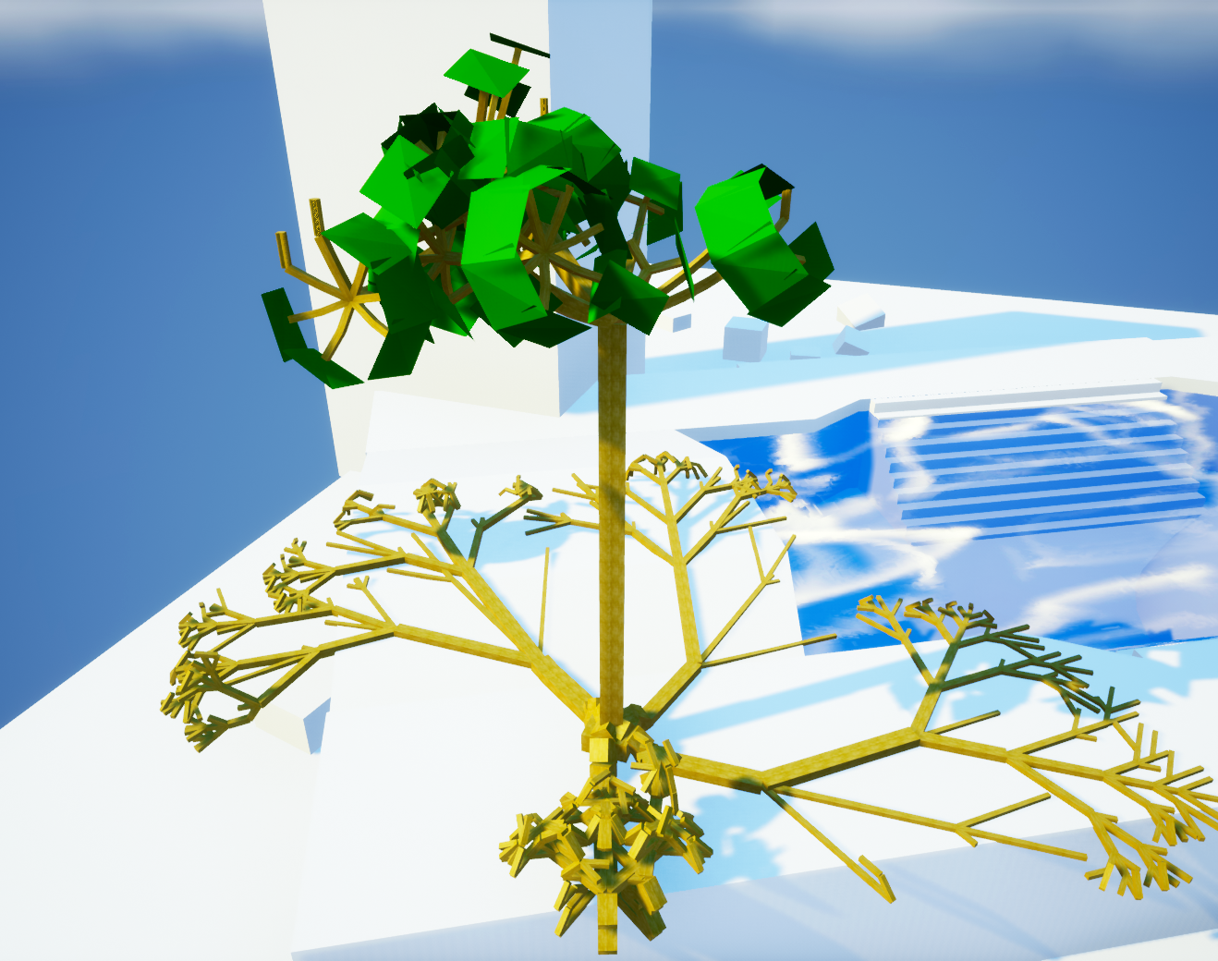
Plant Grow
35 Iterations

Slide 15
Modelled Behaviors
Plants in water are allowed to have more cells
Wind destroys parts of plants that get hit by to much wind
Leafs that get hit by light divide faster and into more children
The diameter of cells grows when a higher „Weight“ rests on them
Growth can have a positive or negative correlation with gravity
Cell division into other cells or environment is forbidden by collision check
Certain cells (i.e. the roots) grow along the floor, or up walls

Slide 16
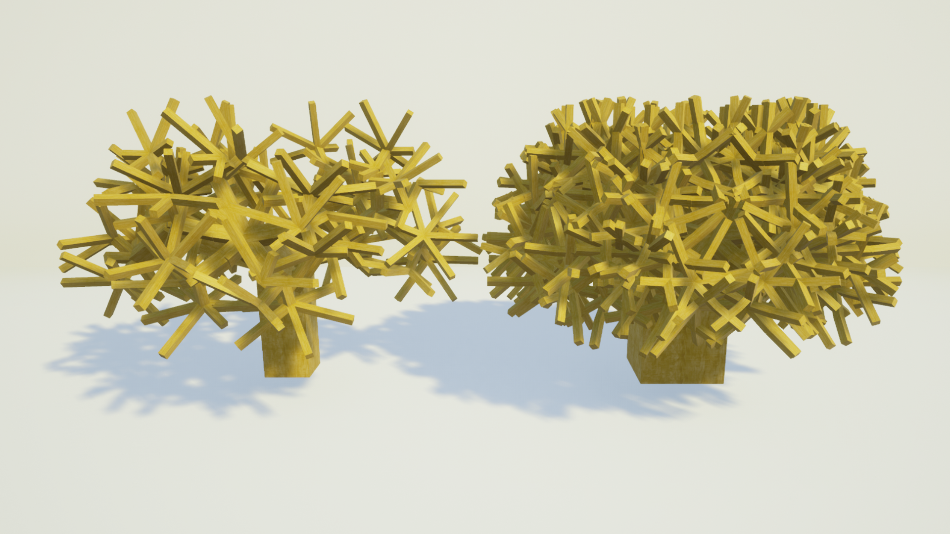
Self-Collision
Left: self-collision disabled; Right: Self-collision disabled
In reality, branches cannot overlap
Cells without children check for possbile collisions, and do not divide if one is found
This greatly reduces, but does not completely prevent collisions
This also adds deterministic, yet seemingly unpredictable structure

Slide 17
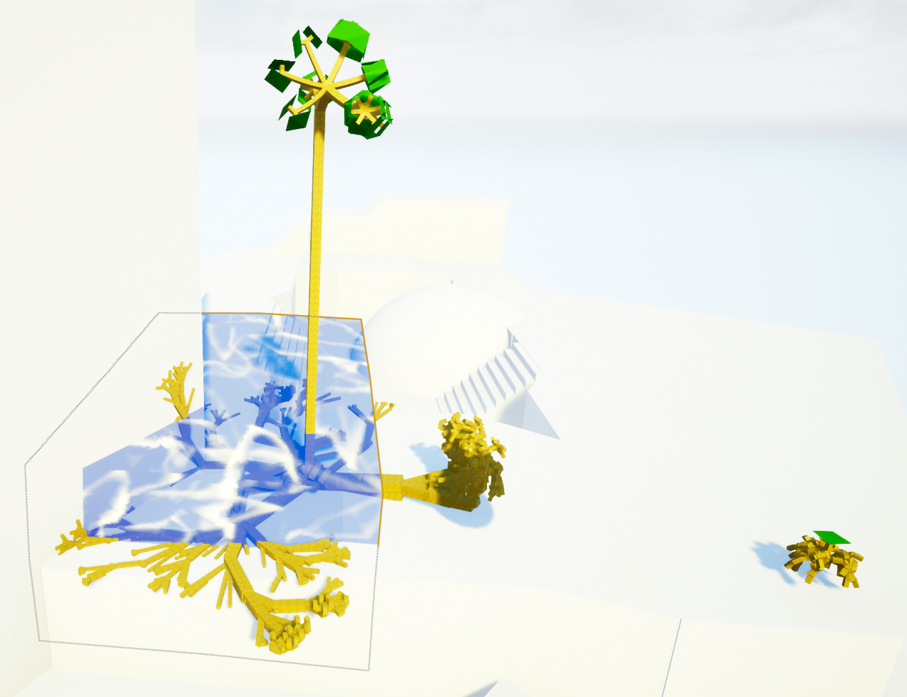
Influence of Water
The plant in the water grows way more than the other one
Distance to light source similar, propertie/”genes” identical
Water is not necessary, but promotes growth to diversify the vegetation
Plants check every iteration how many cells overlap water, and thereby raise the allowed total amount of cells

Slide 18
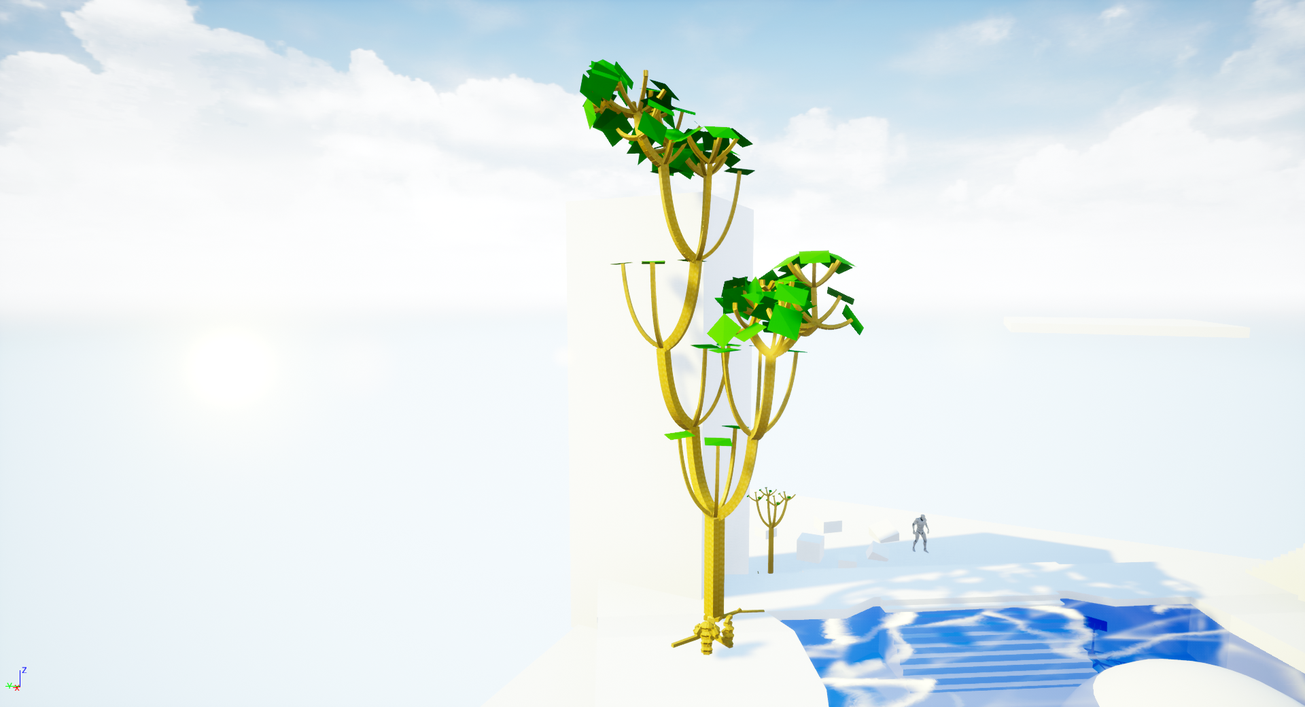
Growth to Light

Slide 19
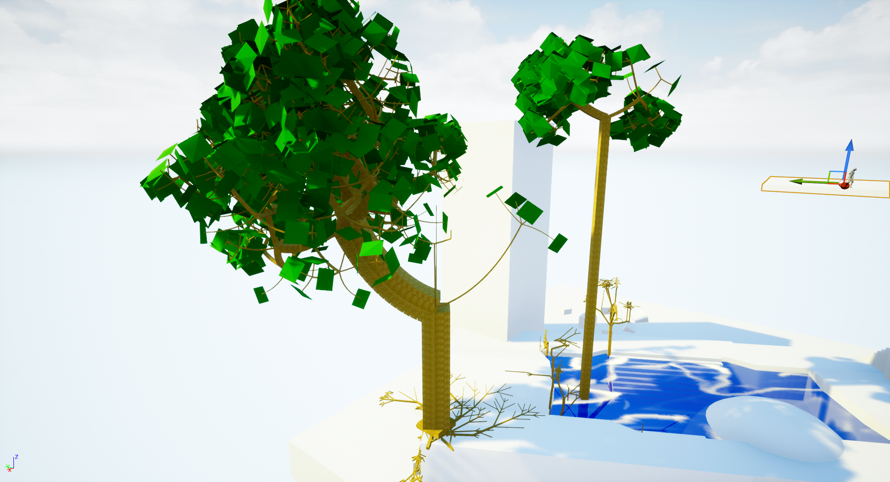
Cell Diameter Growth
Real life trees are bigger where they have to carry a lot of weight (e.g., at the trunk)
Cell diameter raises with the number of “attachement descendants” they have
The two property-identical trees visualize the difference in growth shape of trees in water
Also, they are an example for positive correlation with gravity

Slide 20
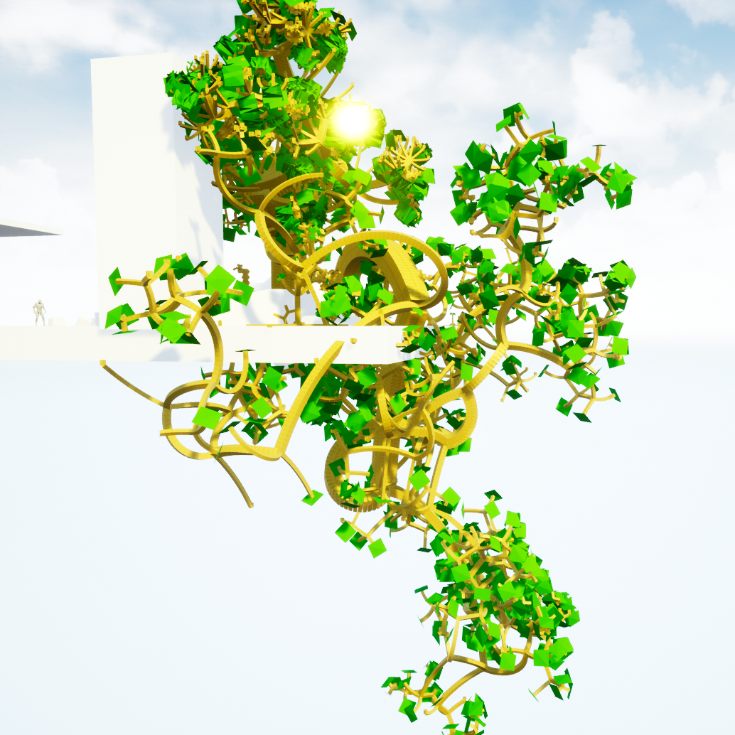
Influence Of Gravity
Negative correlation with gravity leads to trees “bending over”
Many plants, e.g. palms, ferns and willows, show this behavior
The twisted structure of the shown plant emerges as a combination of downward growth and horizontal cell division
This is also expecially prone to provoke mistakes in collision detection

Slide 21
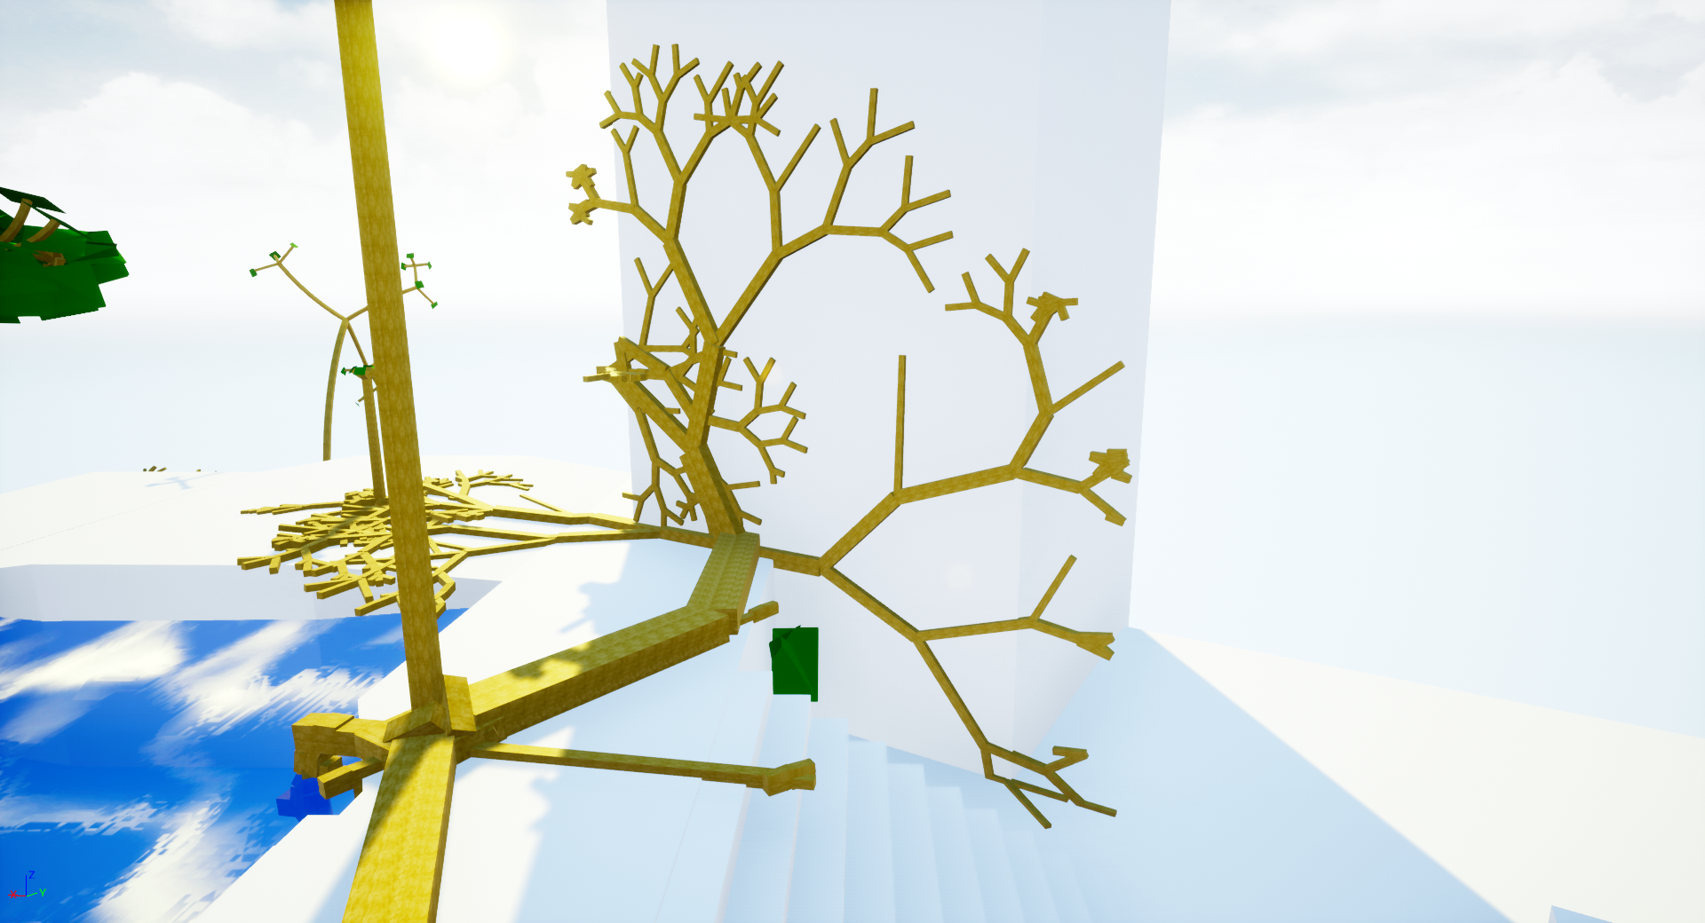
Growth In The Plane

Slide 22
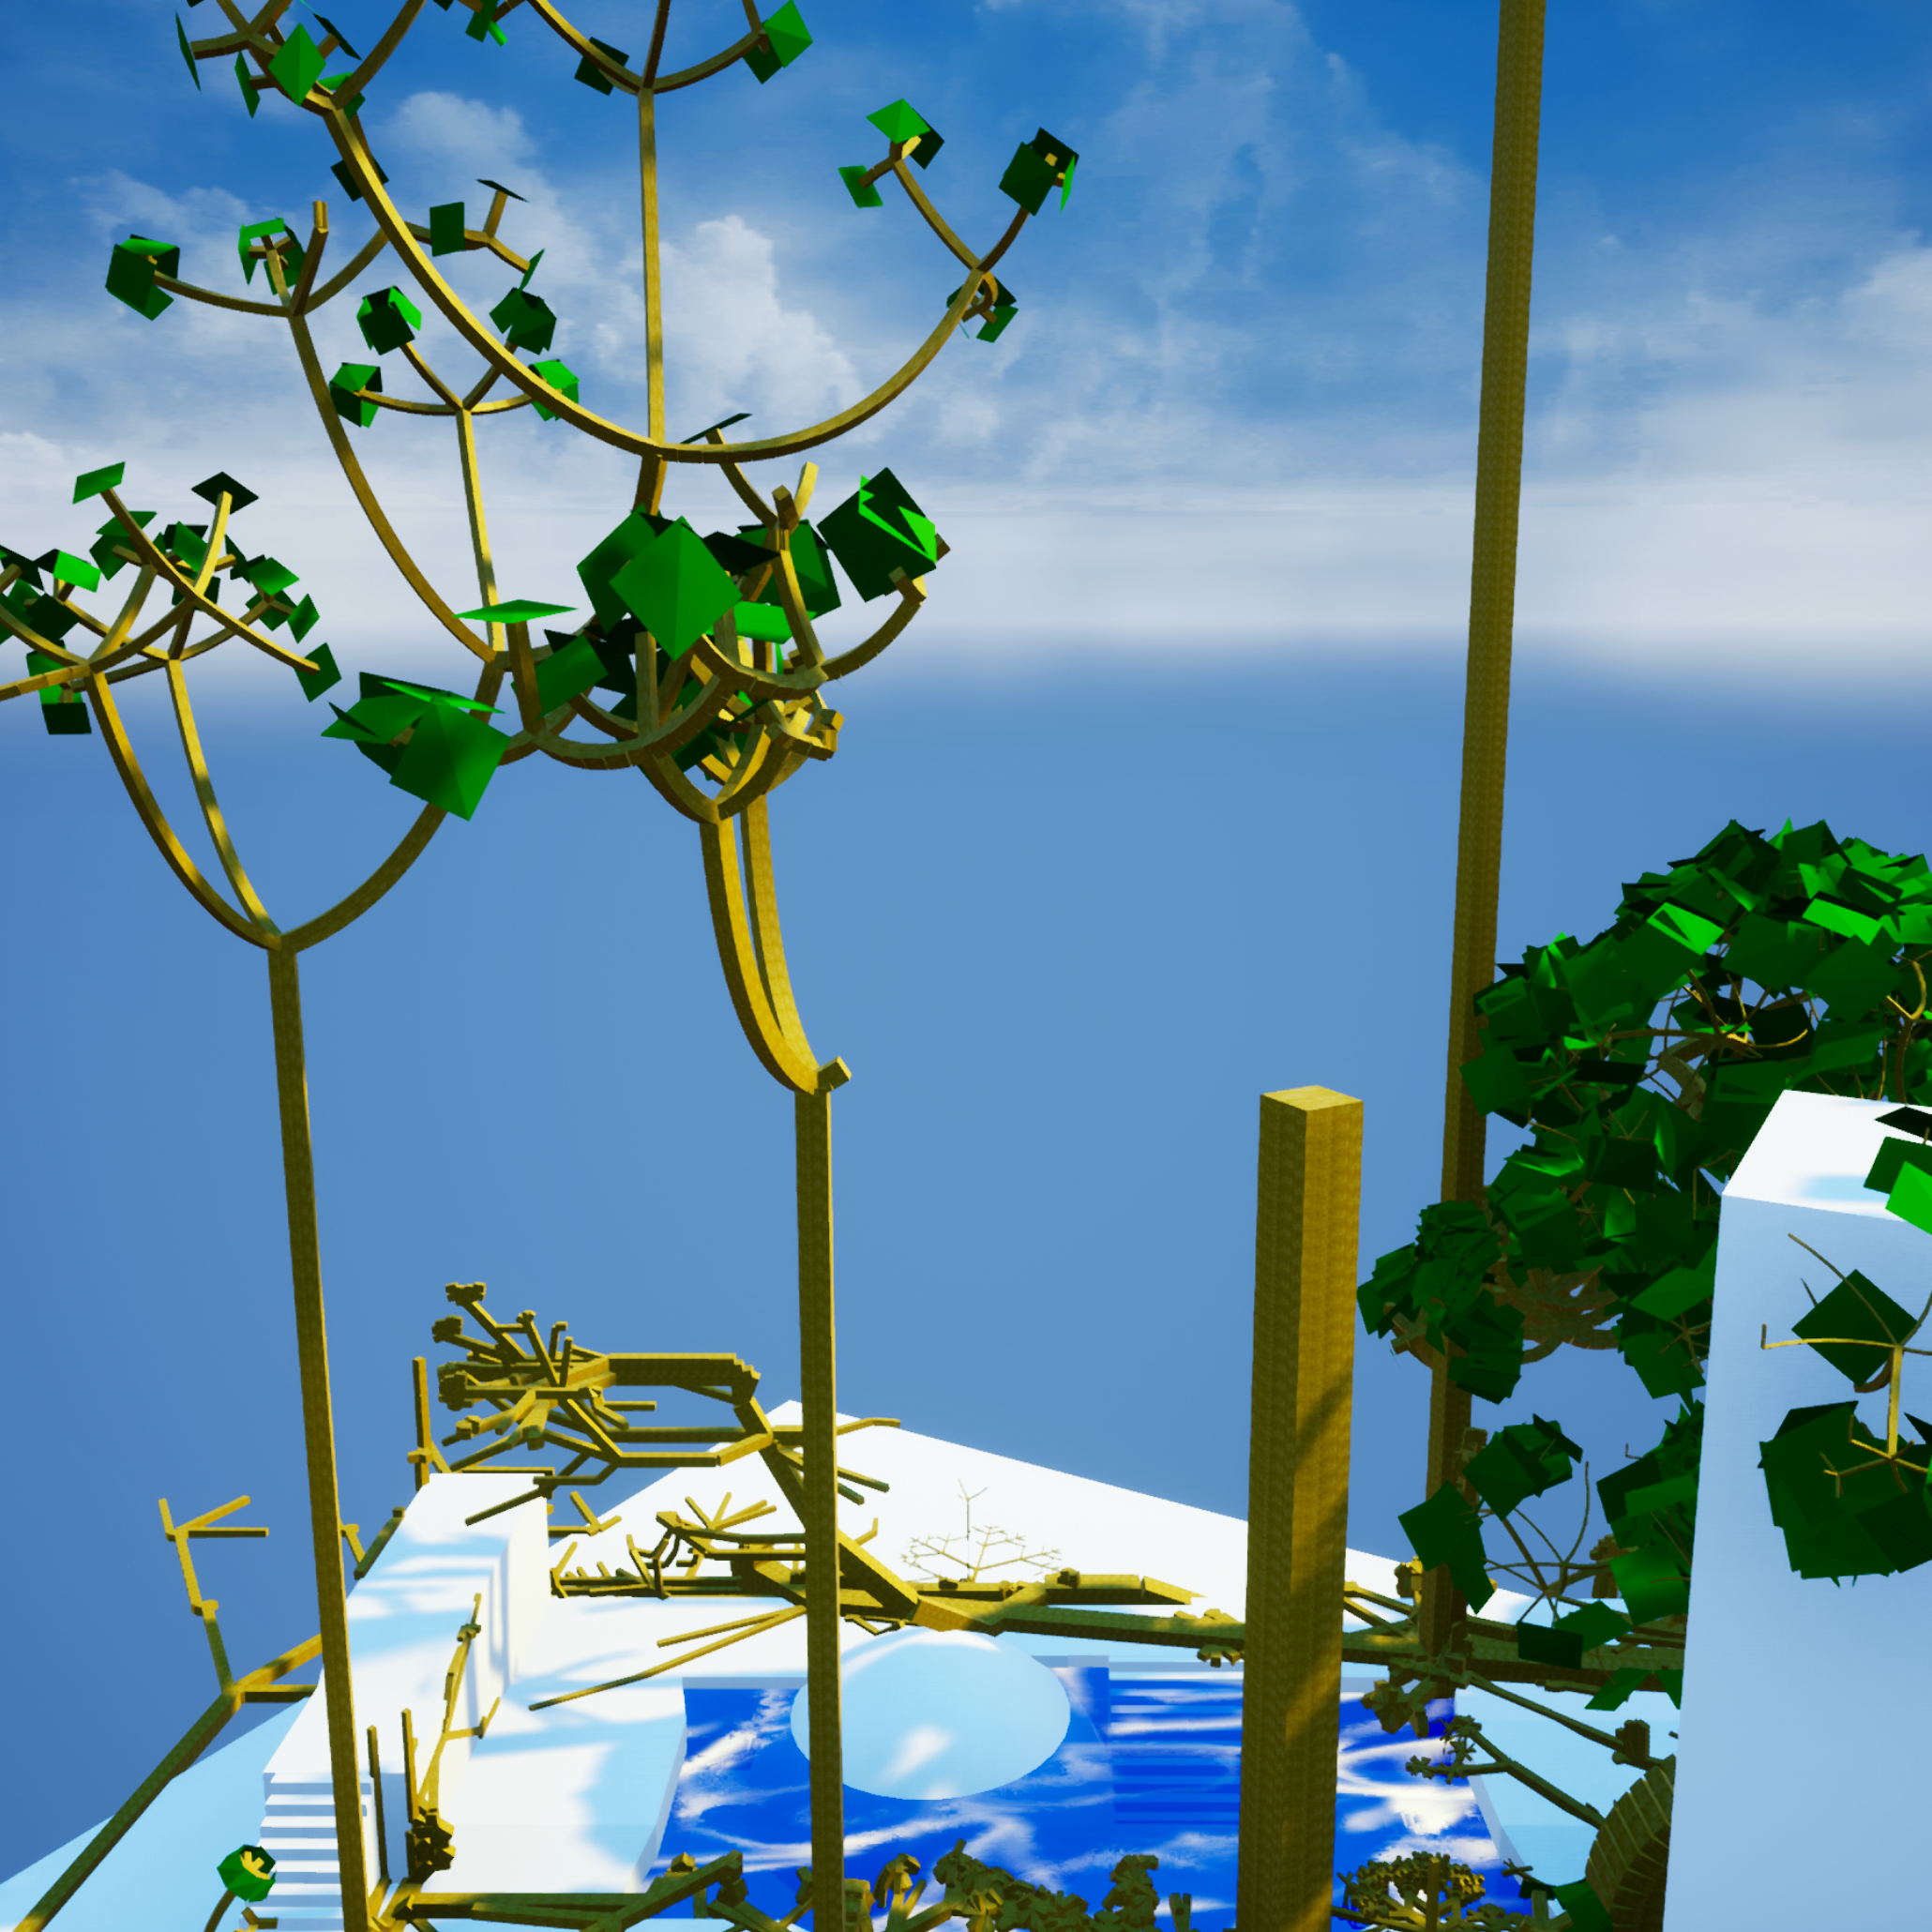
Wind

Slide 23
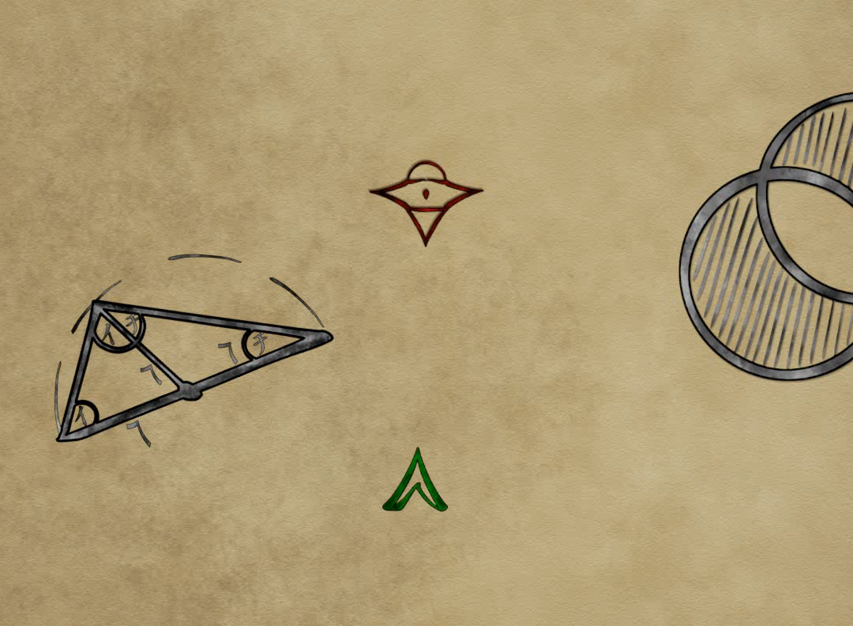
Program Features and Controls
One map where exact values for a plant can be set
One map that renders many plants at once (a “forest)
Character Control by industry-standard WASD/mouse
Jumping and flying by Space
I rerenders the single tree, and adds ten iterations for the forest
M switches Maps
P toggles leaf rendering
O rerandoms the tree and resets the forest

Slide 24
Performance
GPU: Nvidia GTX 760
CPU: Intel i5-4670K 3.40GHz
When not growth iterating, the program always hits 60 fps
Iteration time and distribution on subtasks varies greatly

Slide 25
Going forward
Simulated Ecosystems
This work constitutes a basis to simulate ecosystems
For example, further work could incude nutrient circulation
This would require periodic plant death, and decomposers to return nutritients
Later, completely differently structured organisms („animals“) could be added
Even Spread and Self-Similarity
The possbilities of the plant description model were only scratched on the surface
Current Algorithms yield unsatisfactory results for non-circular degrees of freedom
Other plantal objects (e.g., blossoms) could be recreated with the model
The model could also be extended to allow non-punctiform origins (e.g., for pine cone shaped behavior)

Slide 26
Thank you for your attention. Any Questions?

